Slide 1
Flocculation Model
AguaClara Hydraulic Flocculation Model
Synthesized from 15+ years of laboratory research and conversations with many plant operators
Monroe Weber-Shirk
AguaClara Reach

Slide 2
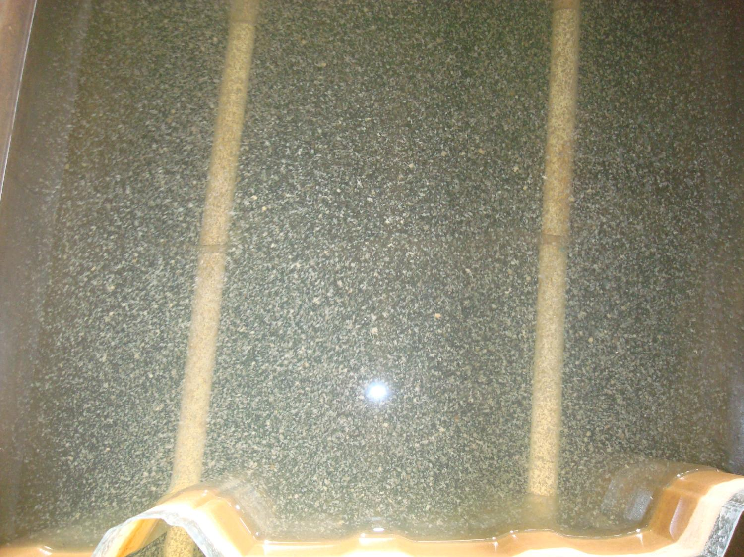

Slide 3
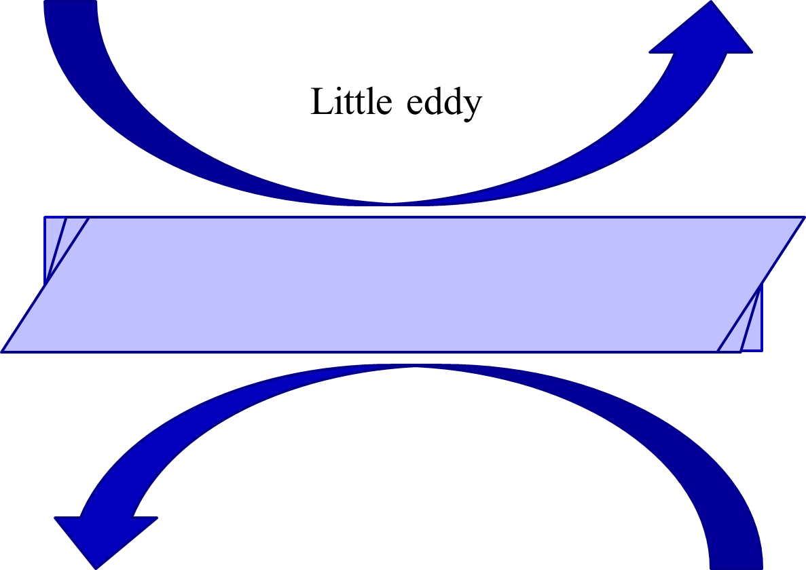
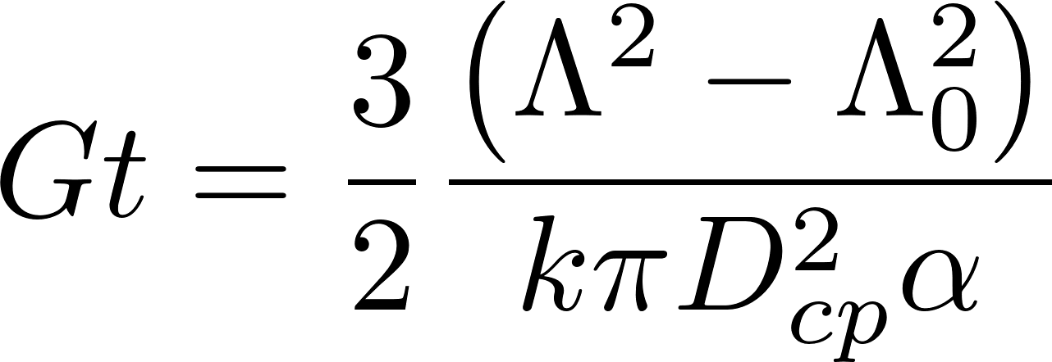
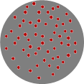
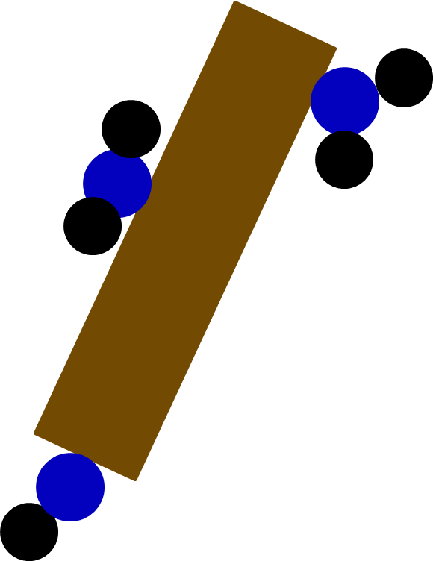
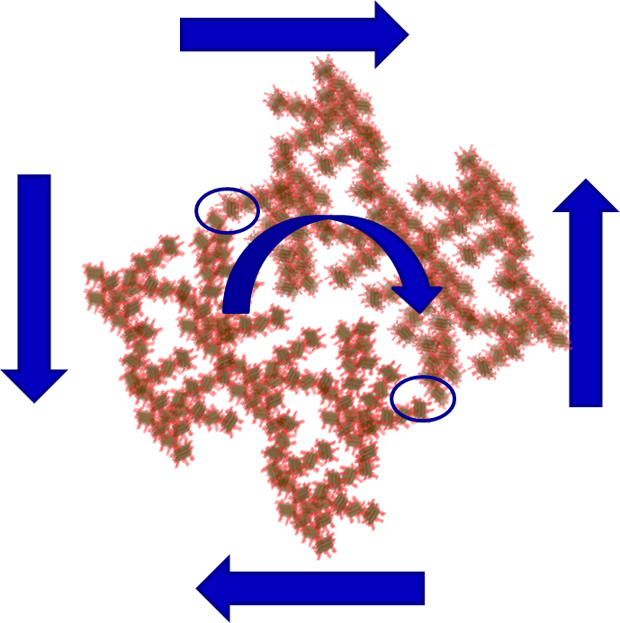
Overview
Energy cascade and creating collisions
Fractals
Predictive model
Surface coverage
Effect of organic matter
Floc size is set by fluid shear

Slide 4
Energy Cascade
Origin of the energy is Mechanical energy – potential or kinetic)
Mechanical Energy is converted into turbulence
Flow expansion - deceleration
Wall shear
Turbulent kinetic energy (chaotic fluid motion – velocity) creates a cascade of eddies at smaller and smaller scales (deceleration happens at smaller and smaller scales)
Viscosity kills the tiniest eddies and converts the turbulent kinetic energy into heat

Slide 5
Viscosity kills Eddies : It takes work to deform the fluid!
Little eddy

Slide 6


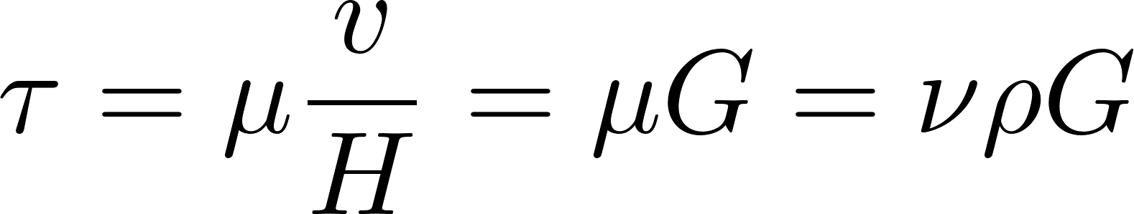
Fluids deform continuously (velocity gradient - G) given a stress (τ)
Dynamic viscosity
Kinematic viscosity
Velocity gradient

Slide 7
If I want to deform the fluid faster, what can I do?
I need faster (more energetic) eddies
Hint: we call it head loss when mechanical energy is converted into turbulent eddies (and ultimately into heat)!
What are the two mechanisms we can use to create head loss?
Wall shear – major losses
Flow expansions – minor losses
Next up: Viscosity dissipates kinetic energy
Little eddy

Slide 8
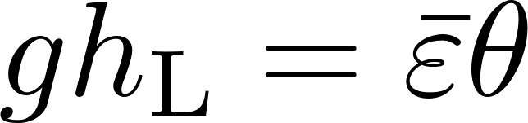
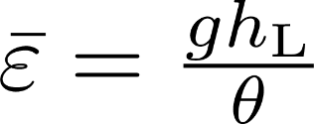
What is the Energy Dissipation Rate? (see AguaClara textbook)
Head loss is the result of dissipation of mechanical energy through viscosity to heat
Lost mechanical energy must be dissipated as heat
Pipe wall shear creates a constant energy dissipation rate in the direction of flow when averaged across the pipe
Expansions (jets) create energy dissipation that decreases rapidly with distance downstream
Where θ is the time over which the energy is dissipated

Slide 9
Units of the Energy Dissipation Rate
The turbulent eddies cause stretching and thinning of concentration gradients and “shuffle” packets of fluid
The intensity of the turbulence can be characterized by the rate at which mechanical energy is being lost to thermal energy
Velocity²/time!

Slide 10

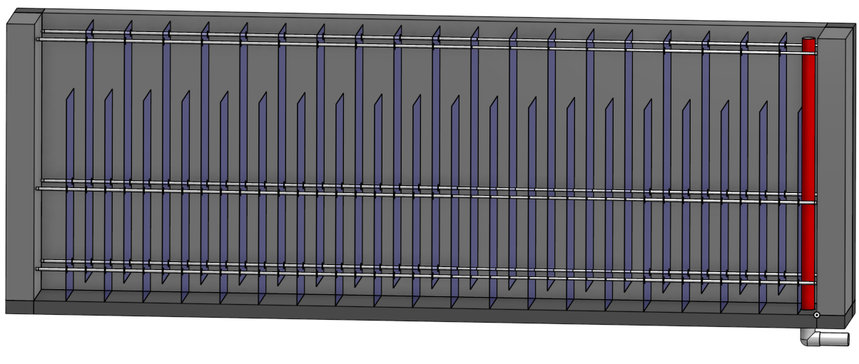
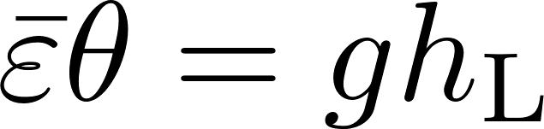
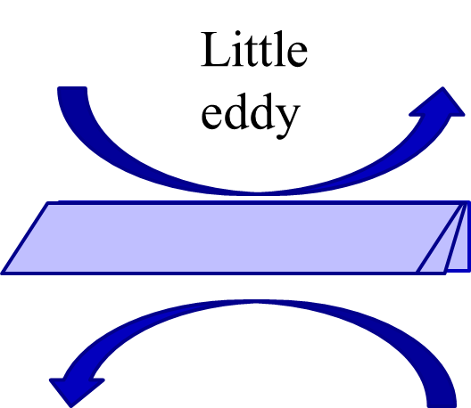
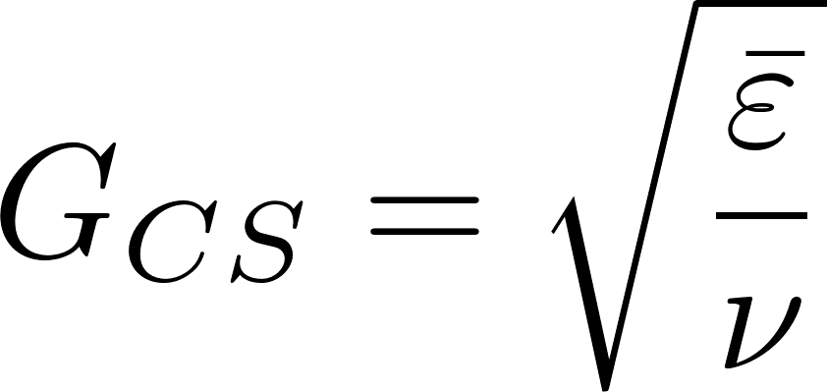
Viscosity connects energy dissipation rate and fluid deformation
A very viscous (ν) fluid won’t deform much (G) given an energy dissipation rate ( )
This would be a great place to use simple dimensional analysis to find the one and only possible relationship !
Lost mechanical energy is dissipated (through turbulence to viscosity)
The rate of energy dissipation divided by the viscosity sets the rate of fluid deformation

Slide 11
Particles grow by colliding with similarly sized particles

Slide 12
The size changes produced by flocculation are dramatic
How many sequential collisions are required to make a 1 mm particle starting from 1 μm particles?
How much larger in volume is the 1 mm diameter particle?
____________
1,000
,000,000 !

Slide 13
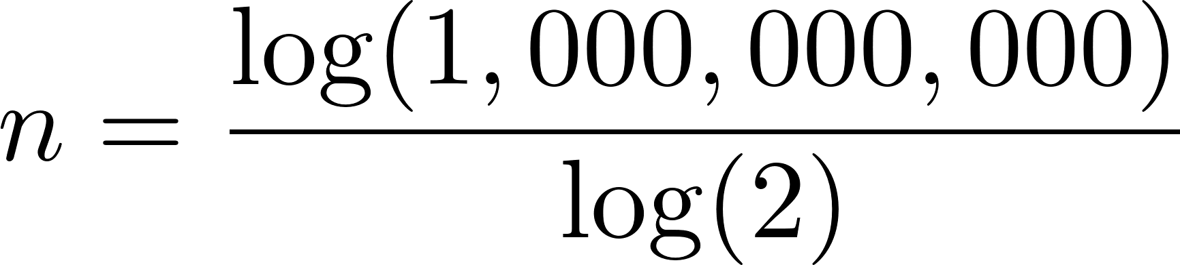
It requires many sequential doubling collisions to make a big floc
1 collision 1+1=2
2 collisions 2+2=4
3 collisions 4+4=8
4 collisions 8+8=16
Number of original particles in the floc = 2^{n}
What is n to obtain 1,000,000,000 = 2^{n}?
n=30
This assumes volume is conserved!
Notes:
Water droplets coalesce and conserve volume!

Slide 14
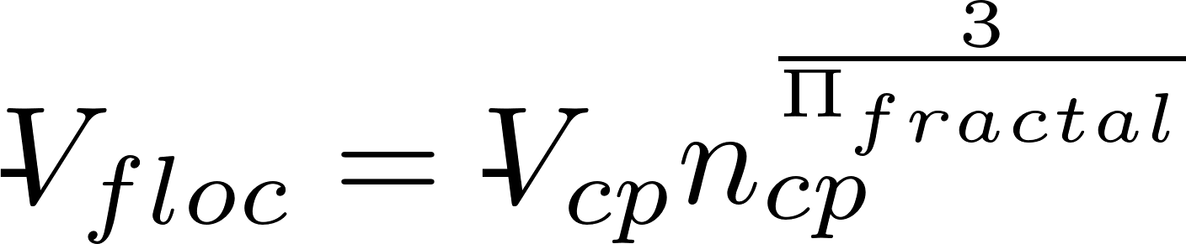
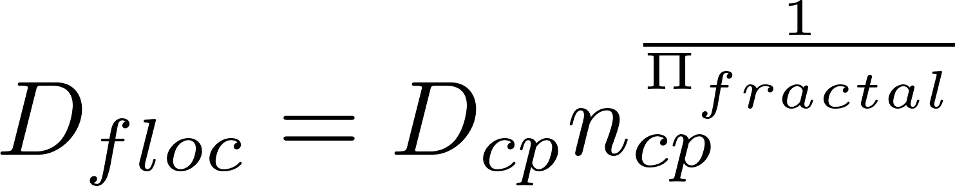
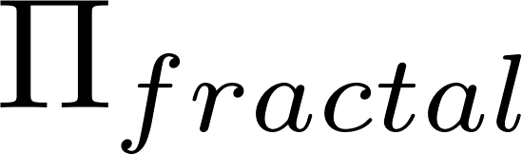
Fractals capture the idea that volume isn’t conserved
What happens to the density of a floc as it grows larger?
Floc density approaches the density of water because the floc includes water
diameter of core particle
diameter of floc
Fractal dimension
Number of primary (or core) particles in the floc
Rain droplets growing in clouds!
3
If volume were conserved, what would be? ____
Is floc mass conserved? _____
No!

Slide 15
Fractal Geometry
Fractal geometry explains the changes in floc density and sedimentation velocity as a function of floc size
The fractal dimension of flocs is approximately 2.0
Further research to quantify the fractal dimension in flocculation (and in floc blankets) is needed
Number of primary particles in the floc
Meakin, P. (1988). Fractal Aggregates. Advances in Colloid and Interface Science, 28 (1988), 249-331.
Notes:
Adachi Wat. Res. Vol. 31, No. 3, pp. 449~54, 1997
If we have a core particle of 5 micrometer
A floc of 1 mm
volume

Slide 16
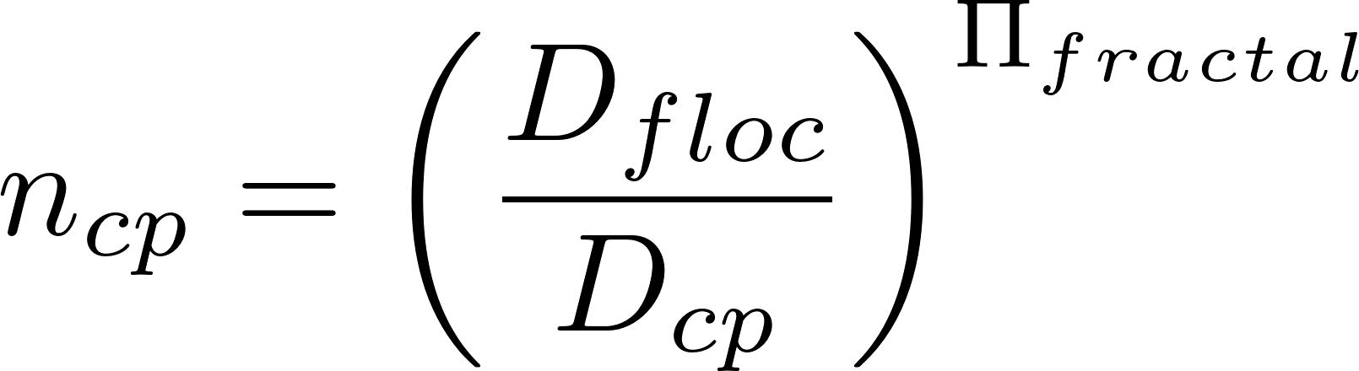
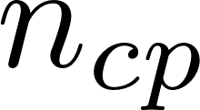
How many core particles in a floc?
Solve for
Assume core particle is 5 μm in diameter
Floc is 3 mm in diameter
Fractal dimension is 2.0
360,000 core particles in a 3 mm diameter floc
Bigger and less dense… Will it settle faster?

Slide 17
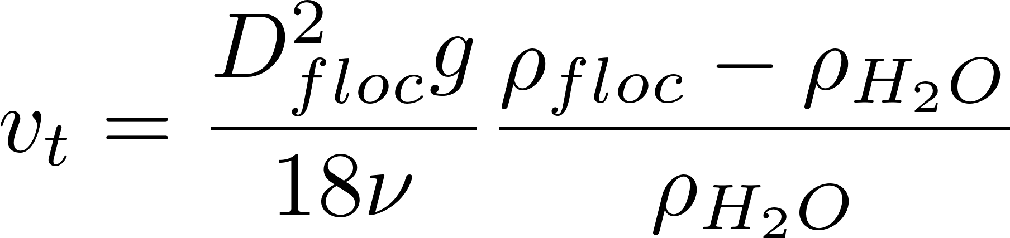
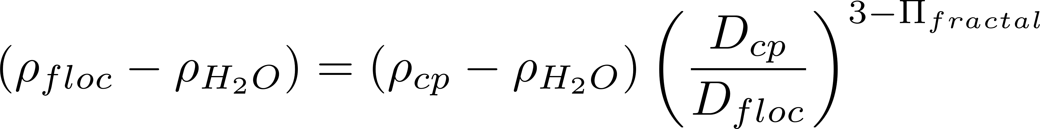
Buoyant Density of Flocs: how much more dense than water is the floc
Floc density decreases rapidly as the floc size increases!
Notes:
Here we assume that the primary particle (clay plus coagulant) is 1 micrometer in diameter.
The assumption is that we are starting with clay at 2650 kg/m^3.

Slide 18
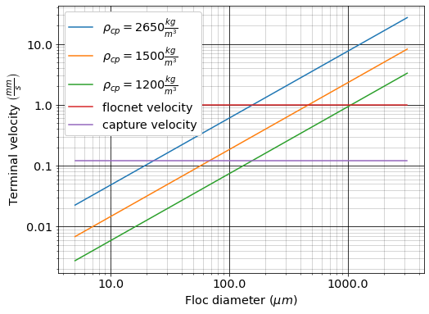
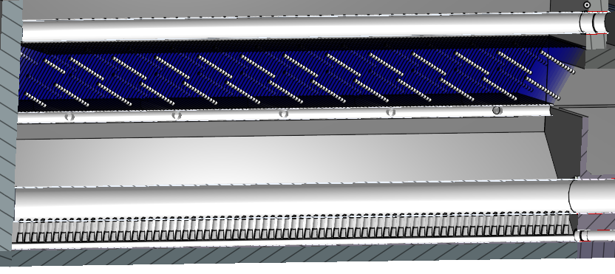
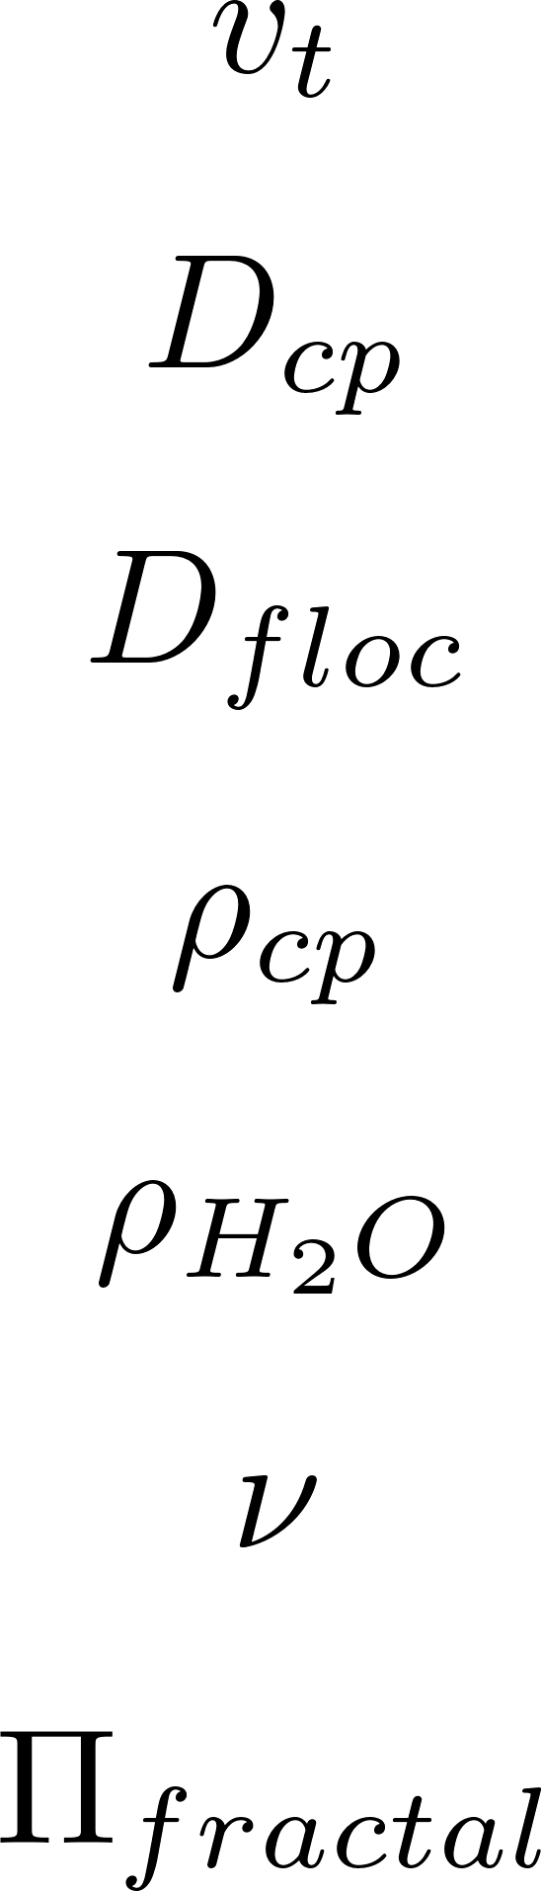
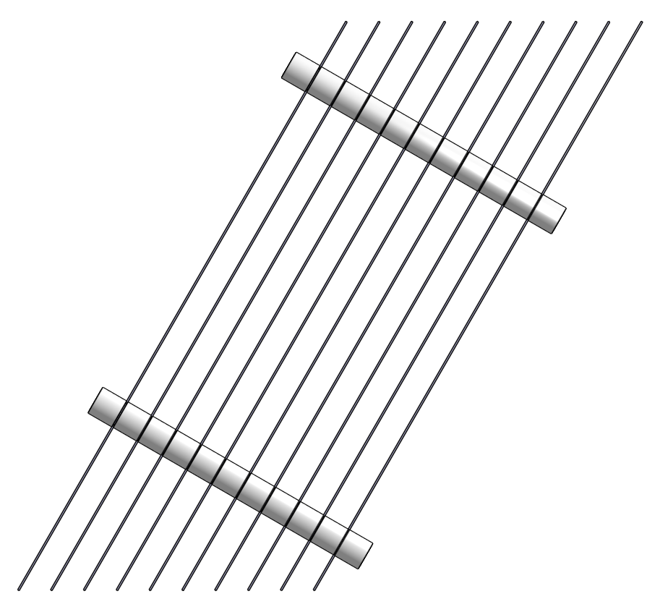
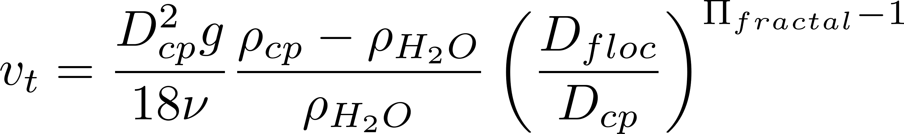
Floc Terminal Velocity does increase with diameter
Terminal velocity
velocity here
Core particle diameter
Floc diameter
How fast a particle must fall to be captured by the plate settlers
Core particle density
Water density
Why flocculation is necessary!
Water kinematic viscosity
Fractal dimension
The model takes into account the fractal influence on density, but ignores the fractal effect of porosity and hence flow through the floc
Notes:
The shape factor adjusts the coefficient of drag for non spherical geometry and according to Tambo has a value of 45/24 for flocs (Tambo et al., 1979). This value is probably not yet well characterized. In any case it is expected to be order 1 because it is a correction to the drag coefficient due to shape.
All fractal dimensions greater than one are expected to increase the terminal velocity as the floc diameter increases.
Both floc blanket upflow velocity and plate settler capture velocity are AguaClara current design values, but are not optimized.

Slide 19
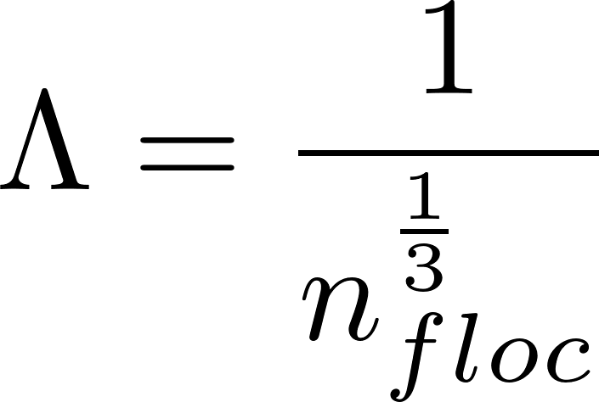
Average distance between particles, Λ, is the cube root of the volume occupied
The average volume of water “occupied” by a particle!
The number of flocs decreases as the flocs grow in size
Given the distance between particles we can determine if collisions are controlled by viscous fluid deformation or by inertia of the turbulent eddies

Slide 20
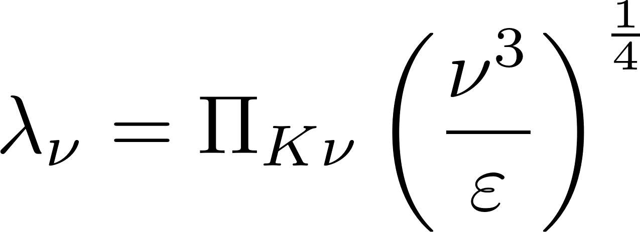
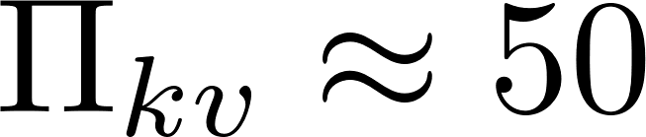
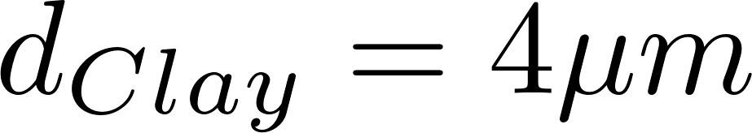
Particle collisions in flocculators (and rapid mix units!) are dominated by viscous shear
Inner viscous scale
Where viscosity kills eddies
Kinematic viscosity
Energy dissipation rate
In drinking water treatment plants, particle separation distances are much less than the viscous length scale
It took us years to figure this out!
inertial
viscous
Notes:
http://dimotakis.caltech.edu/pdf/Dimotakis_JFM2000.pdf (see equation 20 for factor of 50)
Assume clay size is 4 micron.
Rapid mix exploration.xmcd

Slide 21
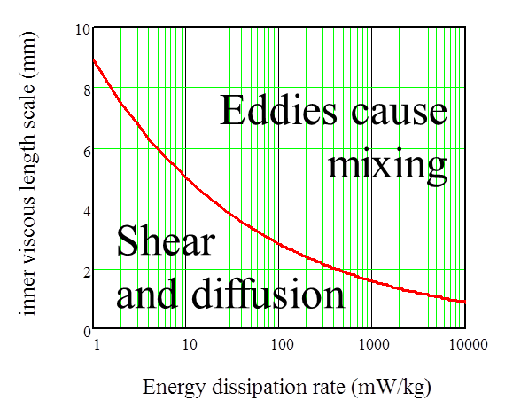
AguaClara Hydraulic Flocculation Model
The relative velocity between flocs is set by viscous shear (not the inertia of turbulence) because their separation distance is less than the scale at which viscosity kills the eddies
The time required per collision is a function of the relative velocity between flocs, the average separation distance between flocs, and the floc projected area
Only similarly sized particles can collide
We only track the concentration of the core particles that haven’t flocculated
See the AguaClara Textbook: The Physics of Water Treatment Design for details

Slide 22
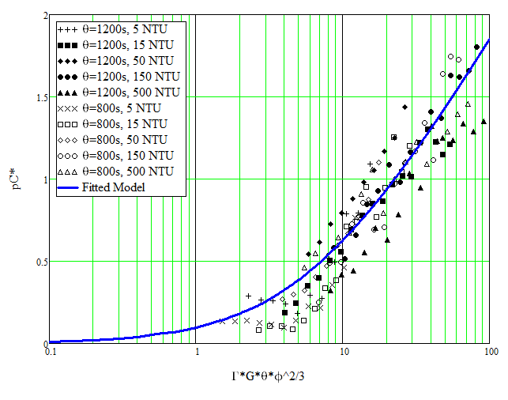
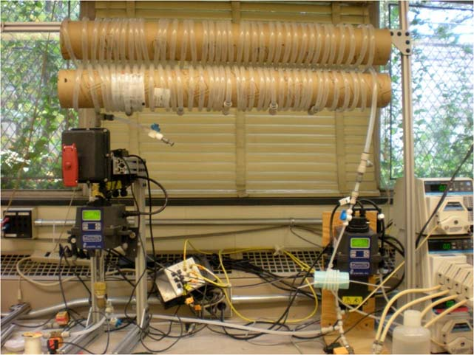
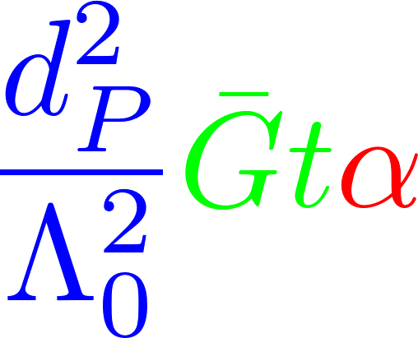
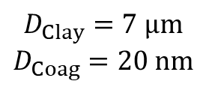
We assumed there was an underlying model that would explain this mess of data
$$D_{Clay}=7 μm$$
$$D_{Coag}=20 nm$$
Dr. Karen Swetland-Johnson
Dissertation research
We methodically tested and discarded hypotheses until we found a set of assumptions that matched the data
Notes:
Model required the assumption that only similar sized particles can collide and attach

Slide 23
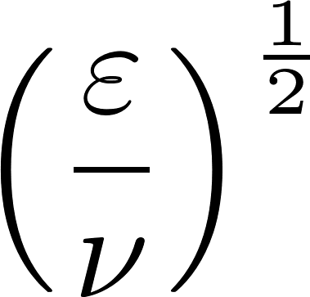
Floc model for collisions caused by fluid deformation
Final particle spacing
Initial particle spacing
Flocculation time
Velocity gradient
Deformation distance over separation distance
Attachment efficiency: A function of fractional surface coverage of the core particle by coagulant nanoparticles
Rate constant (model fitting parameter) : includes info on size distribution
Core particle diameter
Dimensionless concentration of particles that don’t settle

Slide 24
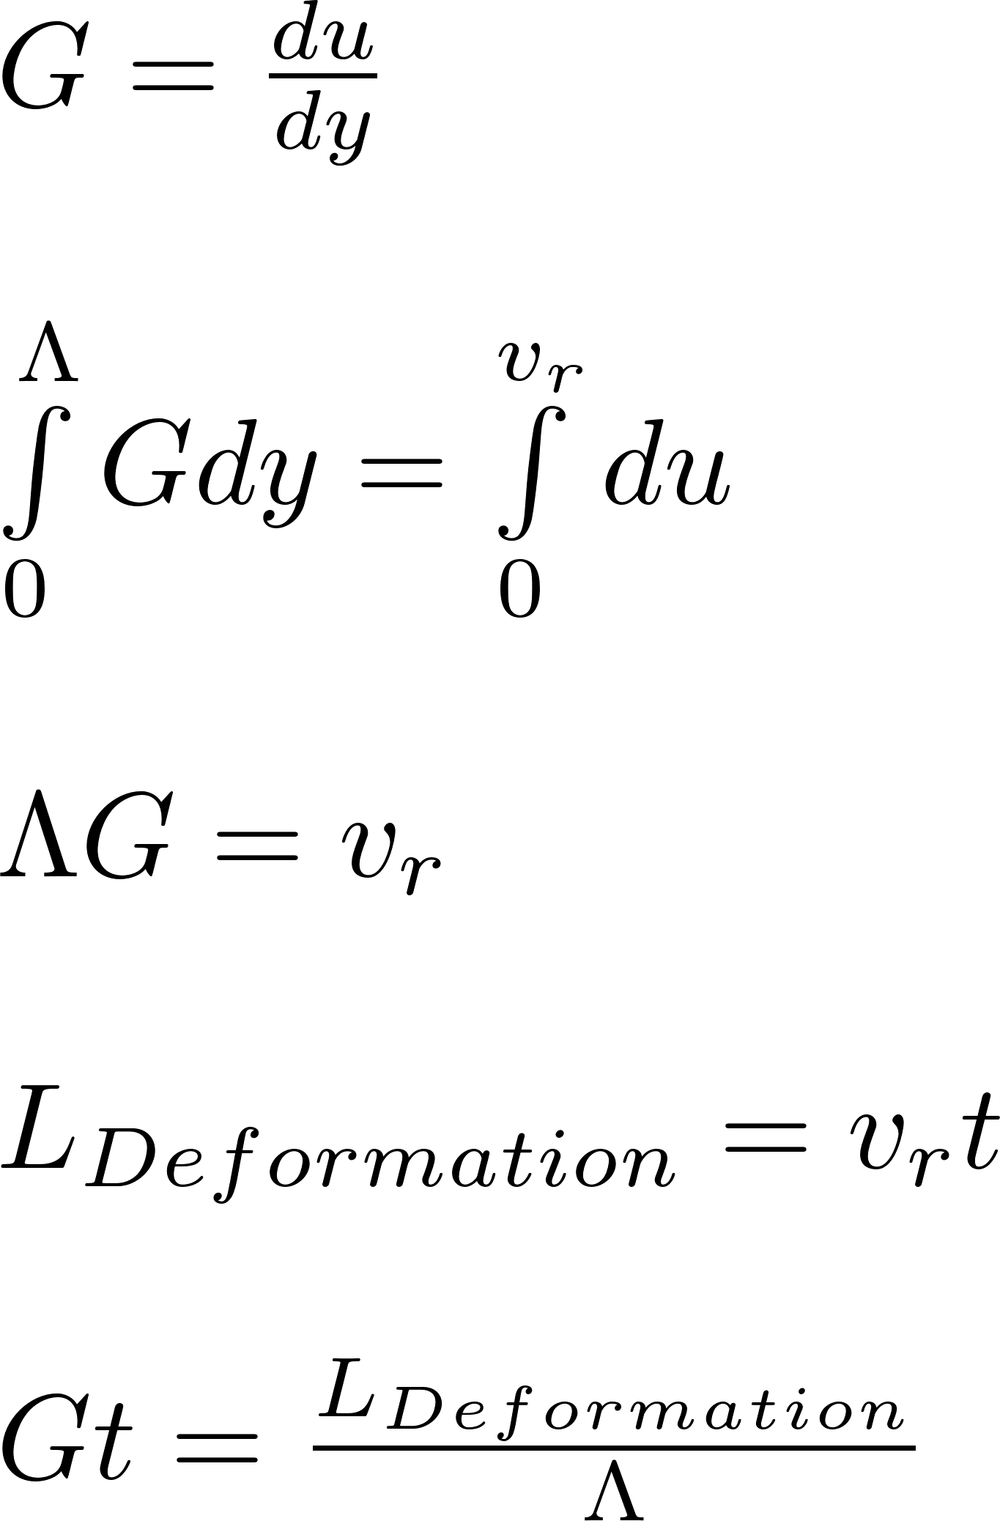

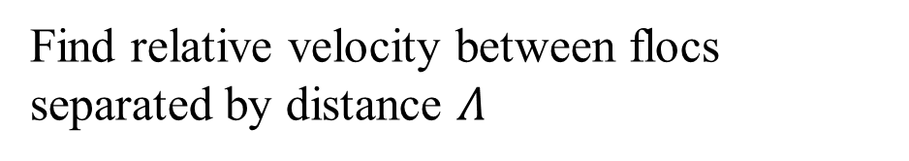


What does Gt mean? (AguaClara uses a Gt of 37,000)
Definition of velocity gradient
y
velocity
$$v_{r}$$
Find relative velocity between flocs separated by distance $Λ$
u
The relative distance traveled due to fluid deformation is proportional to time
y
Displacement in time t
A Gt of 1 means that the particles have a relative displacement equal to their separation distance
$$Λ$$
x
$$L_{Deformation}$$
Notes:
1 mm apart will travel 37 m!

Slide 25
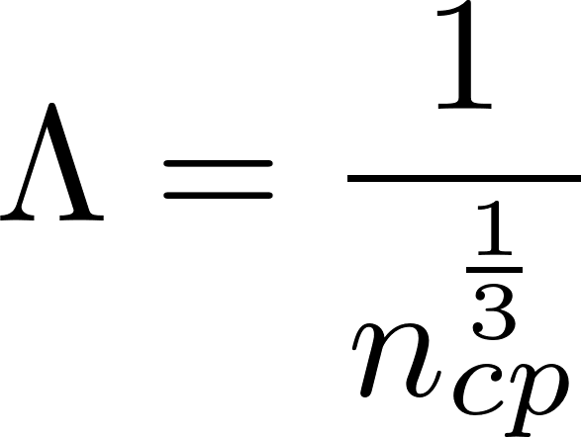
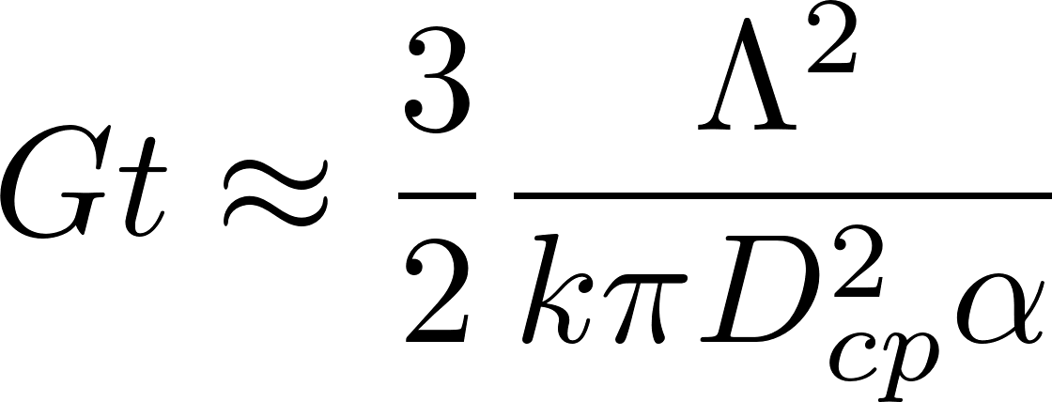
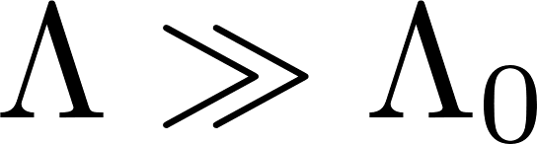
Model Predicts that the distance between core particles will increase
Flocculator can be designed for target settled water turbidity which is almost independent of the raw water turbidity!
Coagulant dose determines the attachment efficiency (and flocculation begins at low dosages)
This model ONLY PREDICTS the separation distance of non-aggregated primary (or core) particles

Slide 26
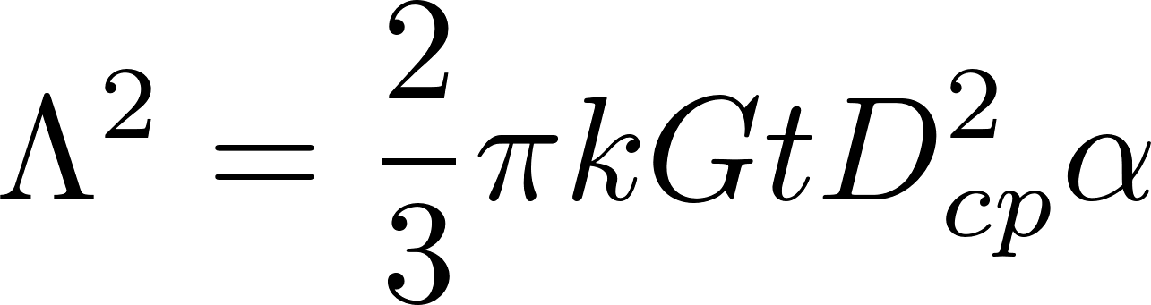
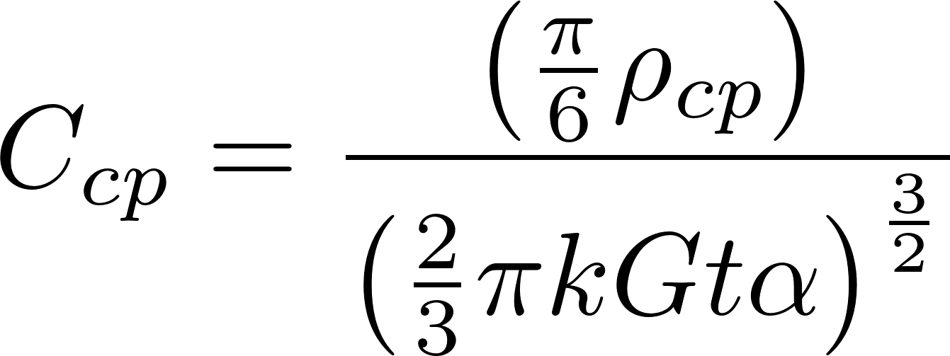
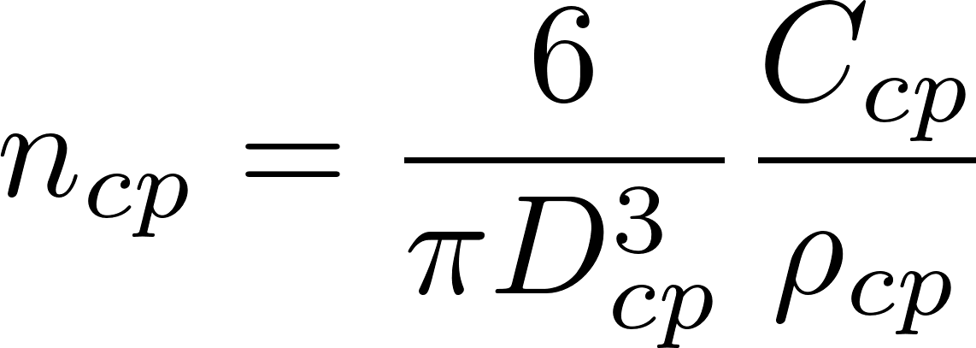
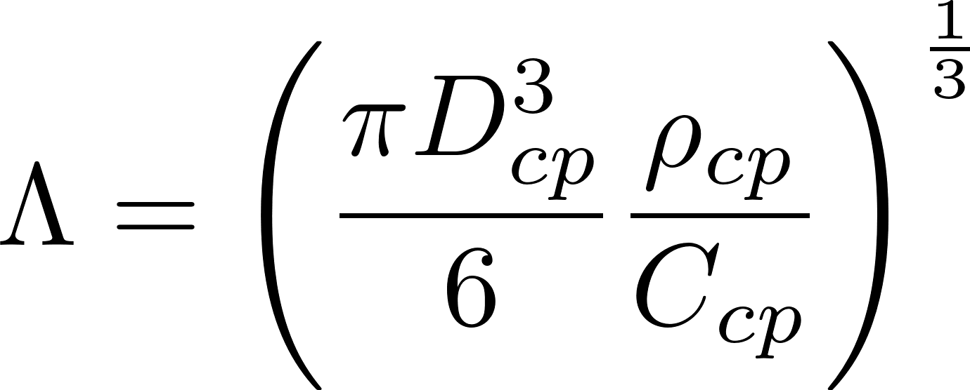
Non-flocculated Primary particle concentration
We can convert the particle spacing into a concentration
k determined by William Pennock to have a value of about 0.03.
Core particle assumed to be 7 micrometer
68 NTU = 100 mg/L Kaolin clay
Coagulant nanoparticles = 90 nm in diameter

Slide 27
Surface Water often has Natural Organic Matter (NOM)
Coagulant nanoparticles are sticky
Natural Organic Matter (NOM) is not sticky

Slide 28
Pre-hydrolyzed coagulant precipitates as stable (and sticky) Al₁₃ clusters (nano particles)
clay

Slide 29
Coagulant precipitate nano particles are sticky!
Coagulant nano particles (sticky)
Clay (not sticky)
Dissolved organic matter (not sticky)
Notes:
Take a sticky note and dip in sugar and then try to get it to stick to your bulletin board.

Slide 30
Natural organic matter adsorbs to the coagulant nanoparticles and coats the sticky surfaces
Observations and a Geometric Explanation of Effects of Humic Acid on Flocculation Y Du, WH Pennock, ML Weber-Shirk, LW Lion Environmental Engineering Science 36 (5), 614-622 (2019)

Slide 31
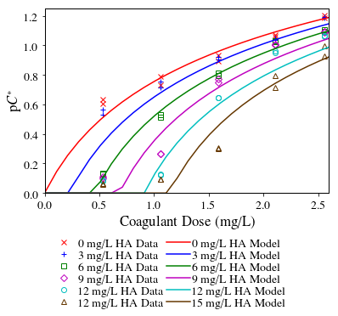
Dissolved organic matter impedes flocculation by covering the coagulant nanoparticles
Humic Acid
(not sticky)
90% efficiency
Coagulant nanoparticles
(sticky)
-log of fraction remaining
Increasing humic acid
Clay (or pathogen!)
(not sticky)
Notes:
No improvement to turbidity until all of the humic acid has attached to coagulant nanoparticles and there are clean surfaces of coagulant left over.

Slide 32
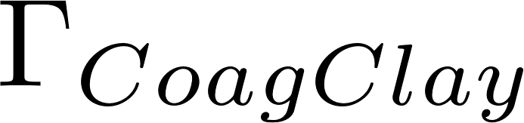
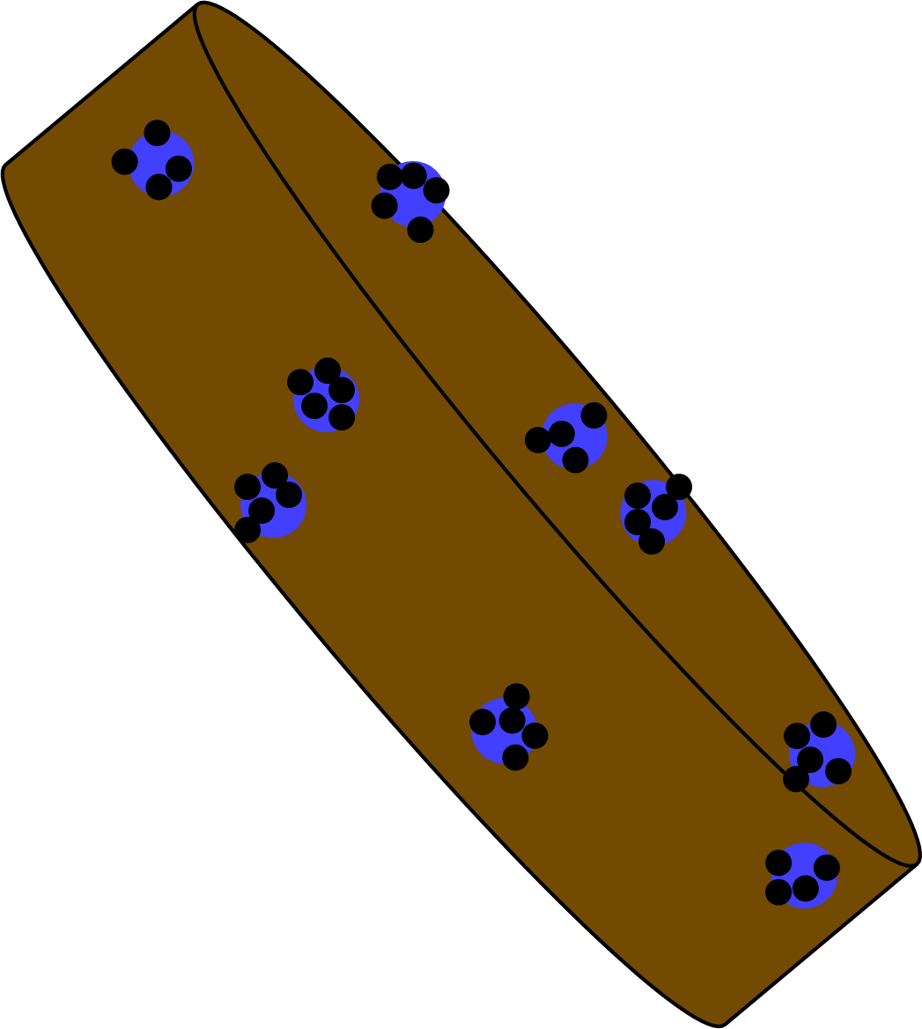
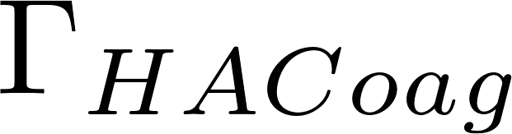
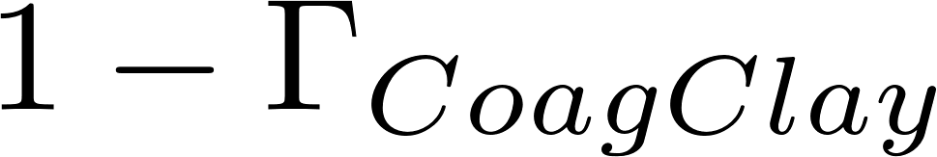

Calculating attachment efficiency
Fraction of clay surface area coated by coagulant (this includes coagulant that is coated with humic acid)
Fraction of coagulant surface area coated by humic acid
Fraction of clay surface area that isn’t coated by anything
Fraction of clay surface area that is coated by clean coagulant
Fraction of clay surface area that is coated by coagulant that is coated by humic acid

Slide 33

There are 3 possible initial points of contact that can lead to attachment
The probability of a clay surface colliding with a PACl surface is equal to twice the probability that the first surface is clay and the second surface is the PACl surface of a PACl-HA nanoaggregate
The probability of a PACl surface colliding with a PACl surface
The probability of a PACl surface colliding with a HA surface

Slide 34

Settled water turbidity can be predicted!
This is remarkable in that the model captures both the effects of inorganic particles and dissolved organic matter.
The model complexity is calculating the probability of a collision that will involve a sticky surface
90% removal
-log of fraction remaining

Slide 35
Flocculation model based on geometry and stickiness of coagulant nanoparticles predicts performance
The coagulant forms sticky nanoparticles
The bond between a coagulant nanoparticle and a clay platelet is strong
The bond between two coagulant nanoparticles might be weaker
Macromolecules of natural organic matter (NOM) cover the coagulant nanoparticles (and NOM isn’t sticky)
There is still much to learn about flocculation!

Slide 36
The flocculation model is far from complete
Doesn’t predict decreasing performance at high coagulant dosages
Possible that coagulant-coagulant bonds are weaker than coagulant-clay bonds and we don’t yet have that effect in the model
Floc density decreases as coagulant dose is increased and it is likely that flocs with excess coagulant have lower terminal velocities
Doesn’t describe floc formation when the dissolved organics concentration is so high that bonds are significant
Doesn’t describe effects of sedimentation tank design (another model coming up!)

Slide 37
We need a basis for choosing the velocity gradient
We know that a value of Gt is required to obtain a low value of settled water turbidity
But what about G? What happens if we use very high G values?
Let G = 10,000 Hz ( and Gt = 35,000)
Tiny flocculator – 3.5 seconds!
Lots of energy – 36 m of head loss
There is another constraint! High G breaks flocs.

Slide 38

Floc maximum size in a flocculator is set by the shear forces and the bond force
Tension plane
Compression plane
Direction of shear by fluid on floc

Slide 39


Flocculator must produce flocs that settle fast enough to be captured by plate settlers
Combine the size of flocs based on their strength and the velocity gradient,
the sedimentation velocity of flocs,
And the floc must settle at least as fast as required by the plate settlers
To obtain the maximum velocity gradient that can be used given the capture velocity of the plate settlers!
Notes:
An increase in viscosity creates smaller flocs
AND flocs settler slower as viscosity increases. So this viscosity effect is compounded

Slide 40

The first equation linking raw water characteristics to flocculator design and sedimentation tank design
Velocity gradient in the flocculator (or the inlet to the sedimentation tank)
Strength of the coagulant nanoparticle bonds with the primary particle
Kinematic viscosity of water (water temperature)
Diameter of the core particle (type of contaminant)
The slowest settling particle that will reliably be captured by the plate settlers
Density of the core particle (type of contaminant)
Density of water
Notes:
Working on a model for density of the core particle
Note the huge effect of temperature

Slide 41

Cold water sets the maximum velocity gradient that can be used
Higher rate sedimentation tanks (higher capture velocity designs) require bigger flocs and thus lower velocity gradients in the flocculator
Notes:
What happens if you design a flocculator/sedimentation tank and the G is higher than the Gmax predicted by the model? (flocs exit the plate settlers)
What happens if you design a flocculator/sedimentation tank and the G is lower than the Gmax predicted by the model? All okay!

Slide 42



Introducing zeta: Composite floc properties that control design of floc/sed
is a function of core particle (raw water particle + coagulant) properties
for kaolin clay suspensions
will have a lower value for smaller diameter and/or lower density core particles. Dissolved organic precipitates are expected to significantly reduce the core particle density.
We need more research!!!

Slide 43


Fractal Flocculation Conclusions
Our goal is to reduce the concentration of the un-flocculated primary particles!
Only similarly sized particles can collide and attach in flocculation
It is difficult to flocculate to a low residual turbidity because the time between effective collisions increases as the number of primary particles decreases
Shear tears flocs apart (or prevents them from attaching)
Notes:
Ha! We can’t design a flocculator without thinking about the sedimentation tank. And maybe someday we will be able to optimize both.

Slide 44
4 Breakout Rooms: Choose a reporter and answer your breakout room number question
Why can’t two particles of different sizes collide in a shear flow?
Why does the floc formed from two smaller flocs have a greater mass than the sum of the masses of the two smaller flocs?
Why don’t any clay particles attach to each other when you add a small amount of coagulant to a raw water that also has dissolved organic matter in it?
What limits the size of flocs exiting the flocculator?
Notes:
Have each team

